Slide 1

saveWildLife inRealTime
Imagine a world where potential poachers protect wildlife

Slide 2

Background: Possible ways to stop poaching are;
Rhino/Elephant de-horning ; so that poachers have less interest in the animal, and Legalize the trading of ivory/rhino horn😈
Train more anti-poaching rangers,
Implanted LoRaWAN(long-range30km wide area network) -equipped sensors directly into the horns of endangered rhinos, accurately monitor the activities of the rhinos and keep them safe from poachers.

Slide 3
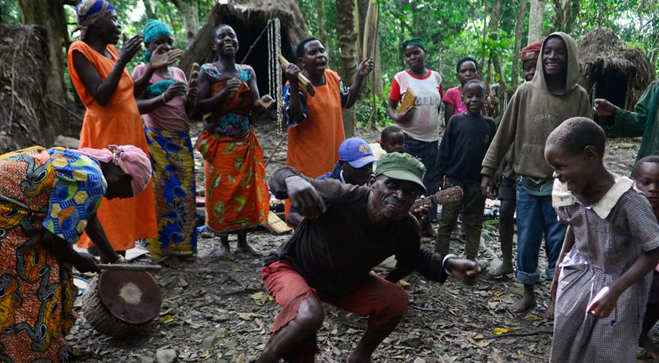
Problem Statement and Main Objective
Fact is, wildlife trafficking is tackled to poverty. So how about motivate poachers and locals with tokens if they can identify and help capture these criminals. ~Basis to our solution ~

Slide 4
How the system works(Web App)
The locals(people around game parks) will have access to the online system and toll free number to report poaching activities, with provision of uploading pics or videos in RealTime. Responsible bodies(game rangers and police) are expected to act immediately on receipt of the poaching alert. After crime confirmation from Ranger, then a direct reward from the system is generated and the Informer’s wallet automatically credited.
N.B:When this data is submitted by the Local/Ranger, a prompt requesting for donation is sent to all app users(tourists mostly). This money can partly be used to motivate the game rangers/locals that would have saved the animal or caught the criminals. But most importantly, this will create awareness to the public of how, when and why wildlife is poached and probably involve them in this real time MOVIE of saving the animal.

Slide 5
References
IOT solution:
https://www.semtech.com/company/press/Semtech-LoRa-Technology-Tracks-Location-of-Endangered-Black-Rhinos-in-Africa
https://www.fastcompany.com/90355176/in-this-rhino-internet-of-things-rhinos-wear-gps-trackers-in-their-horns
Legal rhino horn trade: https://www.savetherhino.org/thorny-issues/legal-trade-in-rhino-horn/

